Slide 1
Heterogenous Multi-Agent Deep Reinforcement Learning for Traffic Lights Control
Authors:
Jeancarlo Argüello Calvo
Ivana Dusparic

Slide 2
Agenda
Introduction
Independent DQN
Evaluation
Results and Analysis
Conclusions and Future Work

Slide 3
Introduction

Slide 4
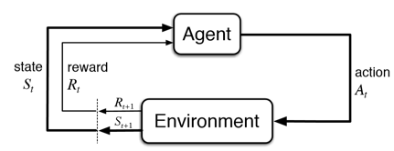
Reinforcement Learning (RL)
Capacity to learn the dynamics of complex problems without any human intervention
Single and multiple junctions
Curse of dimensionality
Exponential growth of the state and action spaces
Richard S. Sutton and Andrew G. Barto, Reinforcement Learning, Second Edition An Introduction. MIT Press, second edi ed., 2018.

Slide 5
Deep Reinforcement Learning (DRL)
Deep Learning + Reinforcement Learning
Neural Networks to tackle curse of dimensionality
Proved to work for single junction
Only homogenous multiple junctions
By taking advantage of the similarity of agents

Slide 6
Independent Deep Q-Network (IDQN)

Slide 7
IDQN
Independent and simultaneous learning
Local policy
Treat other agents as part of the environment
Nonstationary from the point of view of each agent
Dueling Double Deep Q-Networks (DDDQN)
Incompatibility of Experience Replay Memory
Proposed Solution: a fingerprint to disambiguates the age of the data sampled from the replay memory

Slide 8
Deep Q Network
Experience Replay
Stores the agent's experiences at each time step in a dataset
Mini batches drawn uniformly at random from the dataset are applied as Q-updates during the training
Target Network
Separate network (exact copy of Q-Network)
Parameters are only updated with the Q-network parameters every C steps and are held fixed between individual updates

Slide 9
Double DQN (DDQN)
Max operator uses the same values both to select and to evaluate an action.
Select overestimated values, resulting in overoptimistic value estimates
Decouples the selection and evaluation
For DQN:
No decouple target network
Evaluate the greedy policy according to the Q-Network, but using the target network to estimate its value

Slide 10
Prioritized Experience Replay
More frequently samples transitions from which there is a high expected learning progress

Slide 11
Dueling Network
Computes separately the value V(s) and advantage A(s, a) functions
Two streams
Each stream represents one of these functions.
Streams are combined by an convolutional layer to produce an estimate of the state-action value Q(s, a).

Slide 12
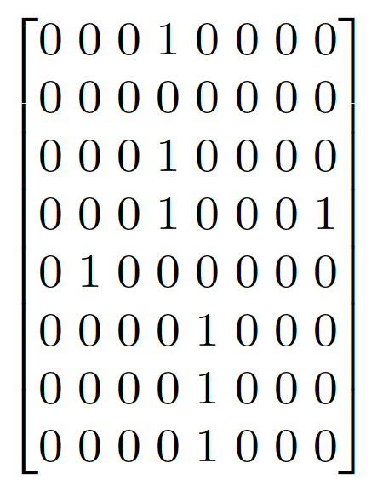
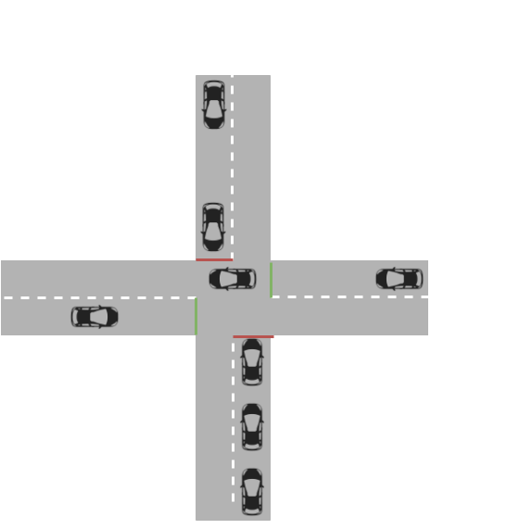
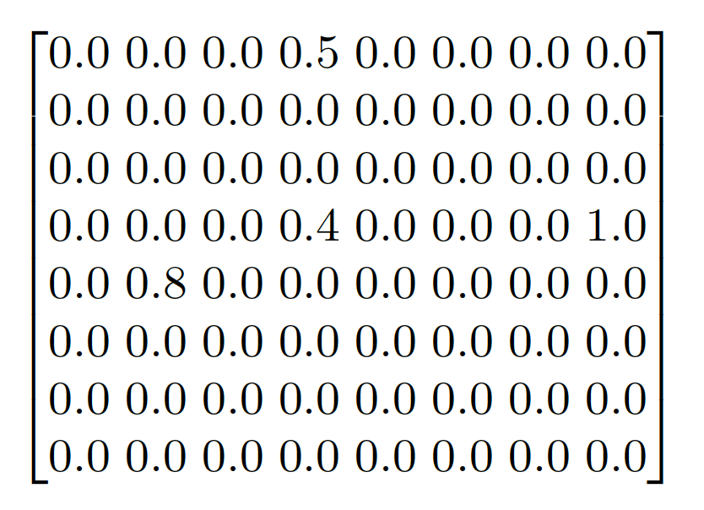
State Representation
Position Matrix
Simulator Environment State
Speed Matrix

Slide 13
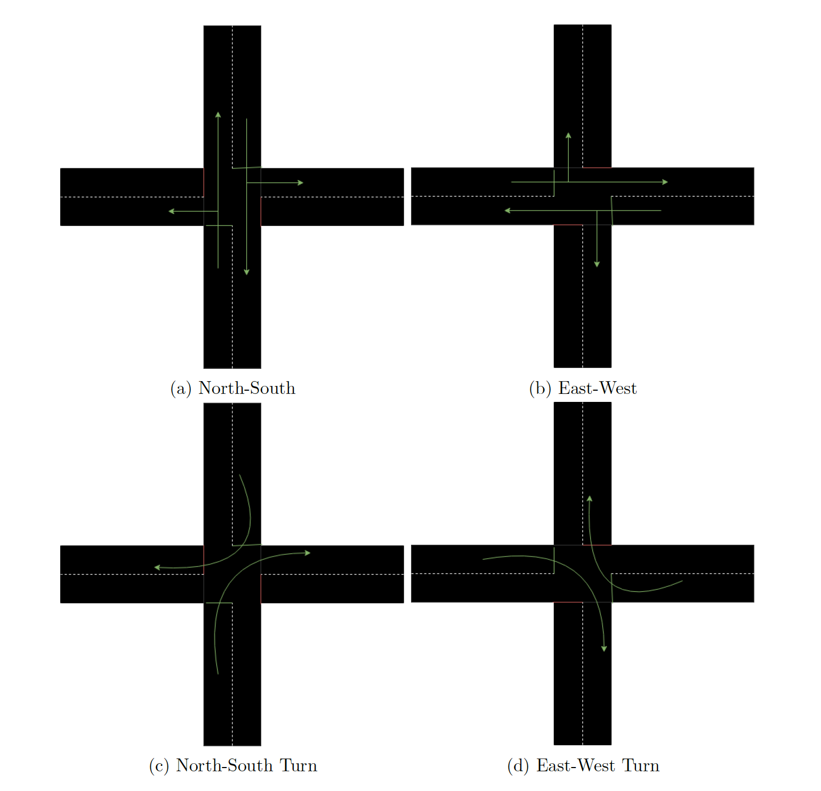
Action Space
Agent with four roads.
A = {NS, EW, NST; EWT}

Slide 14
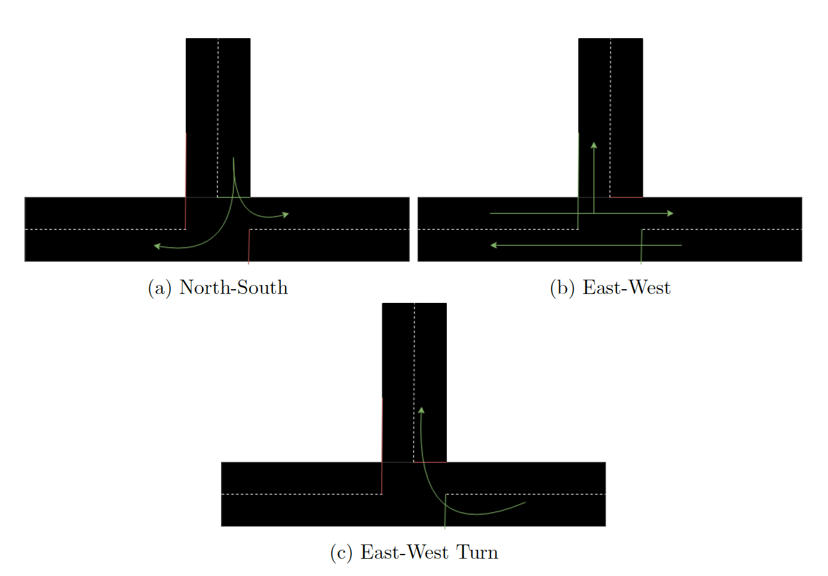
Action Space
Agent with three roads.
A = {NS, EW, EWT}

Slide 15
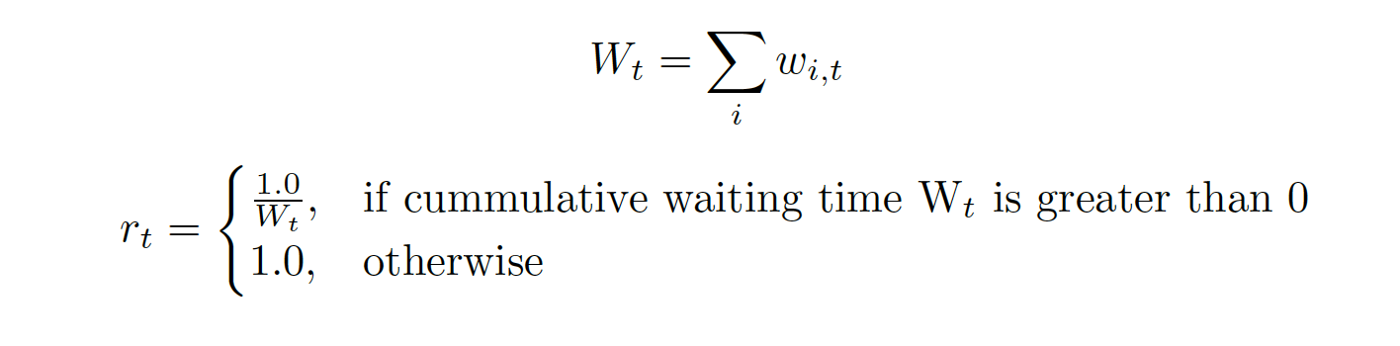
Reward Function

Slide 16
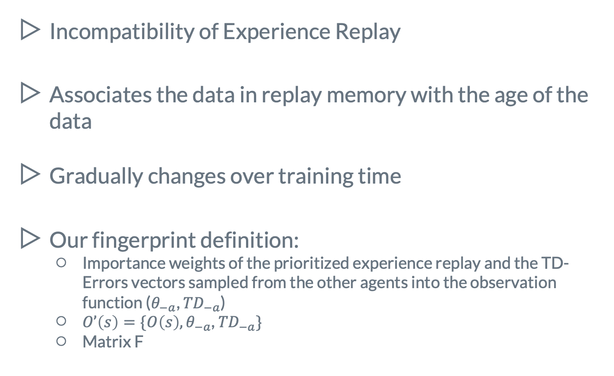
Fingerprint
Incompatibility of Experience Replay
Associates the data in replay memory with the age of the data
Gradually changes over training time
Our fingerprint definition:
Importance weights of the prioritized experience replay and the TD-Errors vectors sampled from the other agents into the observation function (${\text{θ}}_{−a}$, ${TD}_{−a}$)
$O’\left(s\right)=\{O\left(s\right),{\text{θ}}_{−a}\text{, }{TD}_{−a}\}$
Matrix F

Slide 17
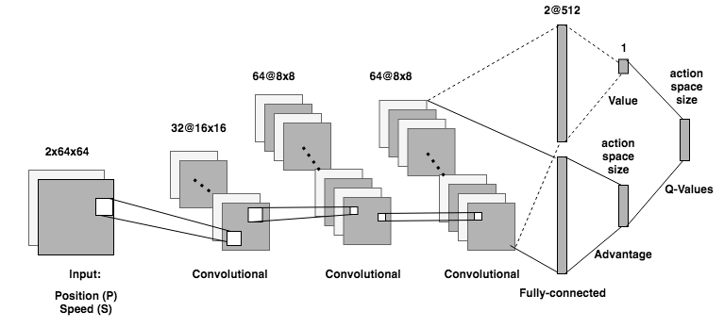
Deep Neural Network Architecture

Slide 18
Evaluation

Slide 19
Simulator of Urban Traffic
OpenAI Baselines: Reinforcement Learning framework
Open source machine learning framework

Slide 20
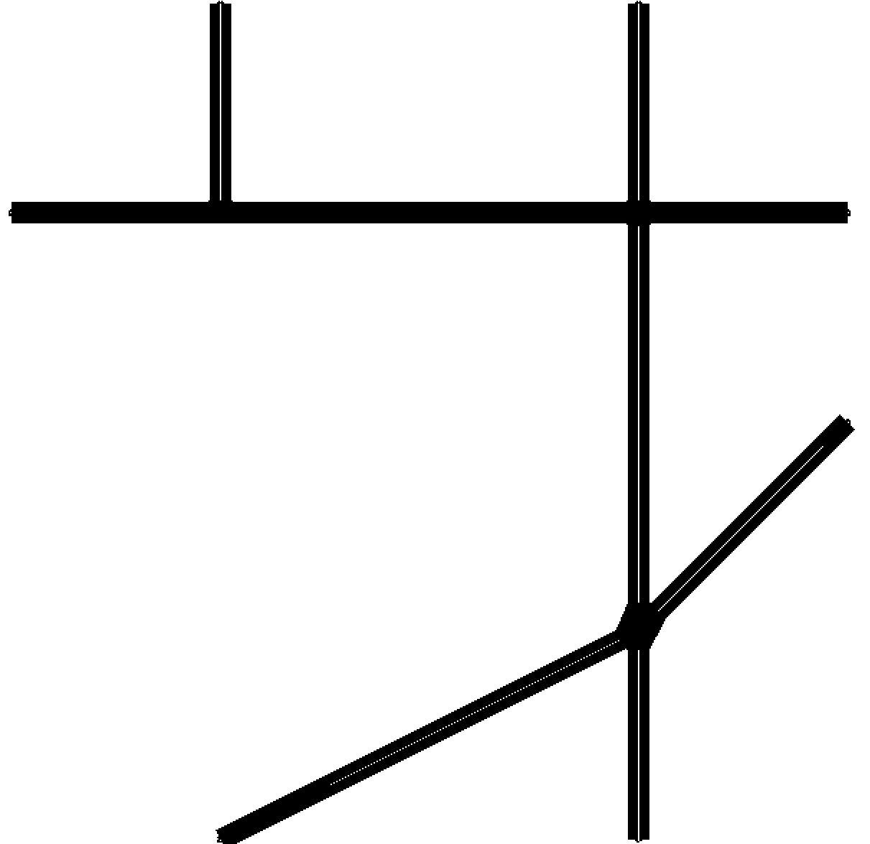
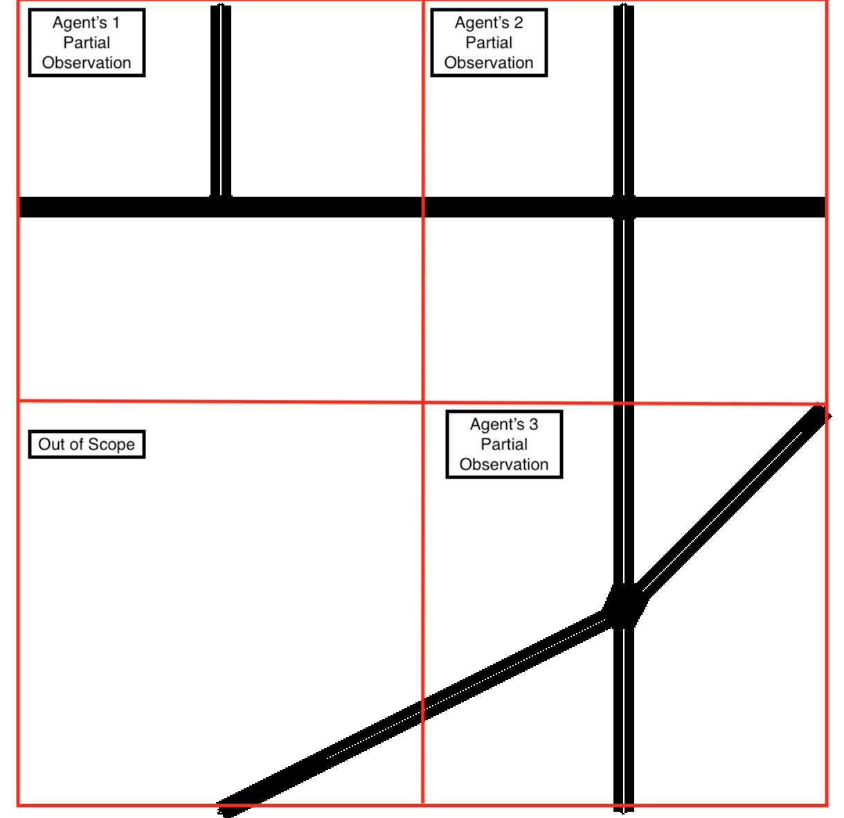
Network Layout

Slide 21
Experiments
Metrics
Cumulative Reward
Average Waiting Time
IDQN combinations
Without experience replay (PEMR Disabled)
With prioritized experience replay (PEMR).
With prioritized experience replay and fingerprint (PEMR + FP)
Fixed time (FT)*
Traffic Conditions
Low traffic load
High traffic load

Slide 22
Results and Analysis

Slide 23
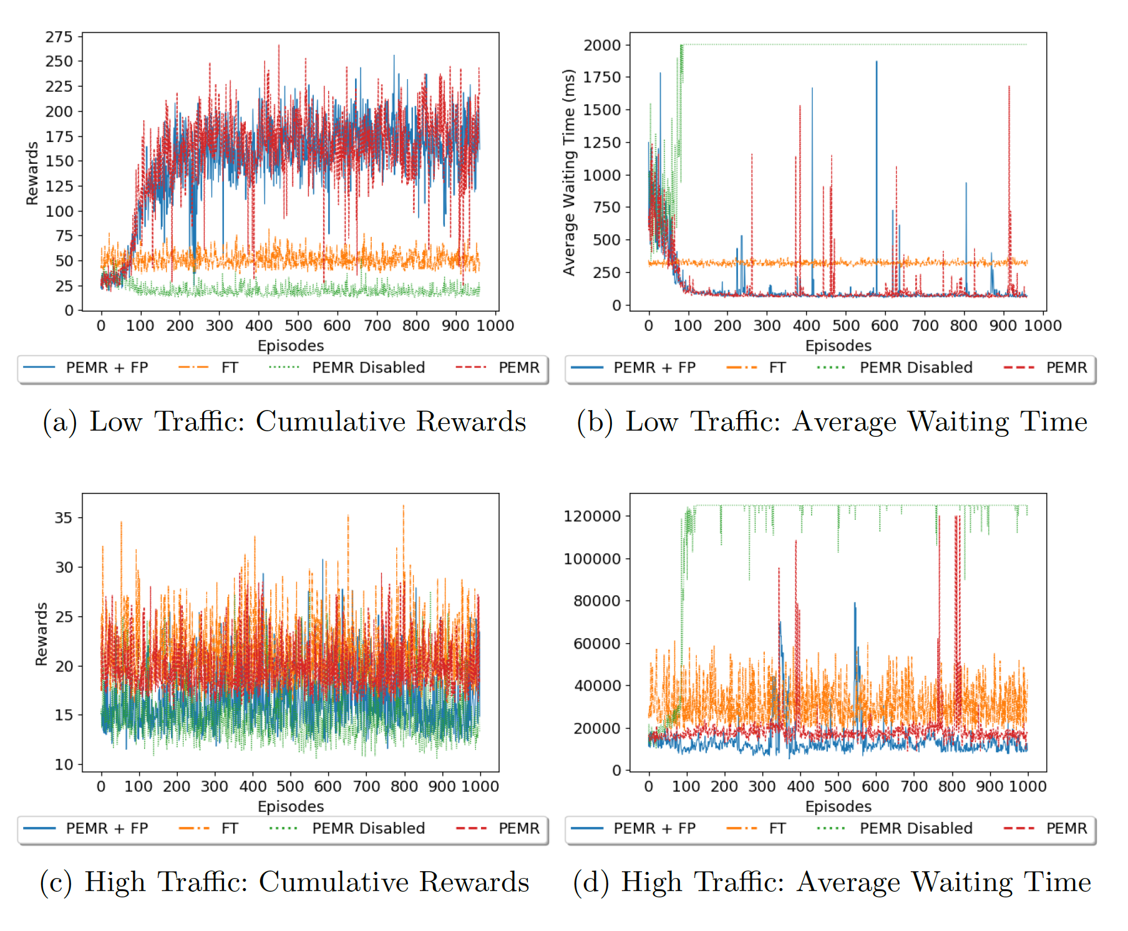

Slide 24
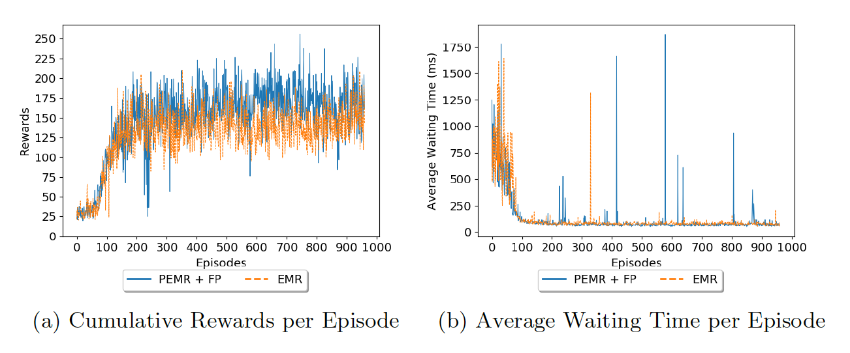
Comparison against Normal experience replay (EMR)

Slide 25
Conclusion and Future Work

Slide 26
First approach for heterogeneous multi-agent DRL in Urban Traffic Control
IDQN is suitable and can deal with non-stationarity
High traffic load requires further investigation
Experience replay mandatory
Further investigation for the fingerprint
Compare against RL approaches
And more…

Slide 27
Thanks!
Any questions?

